Slide 1


Unit Testing in Software Development
Joyce Achieng Ochieng
666816

Slide 2


Understanding Unit Testing Concepts
Unit testing focuses on validating individual components of software. It ensures that each unit operates in isolation, similar to how Lego bricks connect independently. This approach helps maintain modularity, making it easier to troubleshoot and enhance software.

Slide 3

Why Do We Need Unit Testing?
Unit testing is essential in managing complex software systems. It helps identify issues early, reducing costs associated with fixing bugs later in the development cycle. Catching problems proactively ensures a more stable and reliable software product.

Slide 4

Key Benefits of Unit Testing
Quality
Refactoring
Unit testing ensures that individual components perform as expected, thus enhancing overall software quality.
With unit tests in place, developers can confidently refactor code, knowing that existing functionality remains intact.
Debugging
Documentation
Unit tests help in quickly identifying and fixing bugs, thereby reducing the time spent debugging.
Unit tests serve as a form of live documentation, illustrating how code is meant to function and be used.

Slide 5
Characteristics of Good Unit Tests
Isolated
Deterministic
Tests should run independently, ensuring no external factors affect their outcomes.
Each test should produce the same result every time it is executed with the same conditions.
Fast
Independent
Tests must execute quickly, enabling rapid feedback during the development cycle.
Each test should not rely on others, promoting flexibility in the testing process.

Slide 6
Characteristics of Good Unit Tests
Readable
Clear Names
Tests should be easy to understand, allowing developers to quickly grasp their purpose.
Use descriptive names for tests to convey their intent and functionality clearly.
Edge Cases
Short
Address edge cases to ensure the software handles unexpected inputs and scenarios gracefully.
Keep tests concise to improve maintainability and facilitate quick execution during development.

Slide 7

Best Practices for Effective Unit Testing
Utilizing mocks and automation can significantly enhance the effectiveness of unit testing. Mocks allow for isolating components, while automation ensures tests are run consistently and efficiently, leading to a more robust testing framework.

Slide 8
Common Pitfalls in Unit Testing
Too Broad
Skipping Edges
Tests that are too broad may not effectively isolate issues, making debugging difficult.
Ignoring edge cases can lead to unexpected failures during real-world use of the software.
Flaky Tests
Over-Reliance
Tests that occasionally fail without changes can cause frustration and undermine trust in the test suite.
Relying solely on unit tests may lead to gaps in overall testing strategy, missing integration issues.

Slide 9

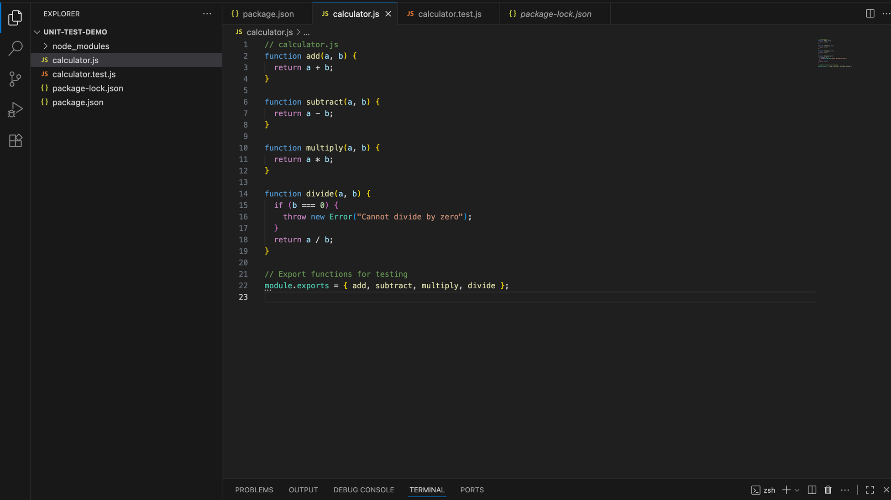

Slide 10
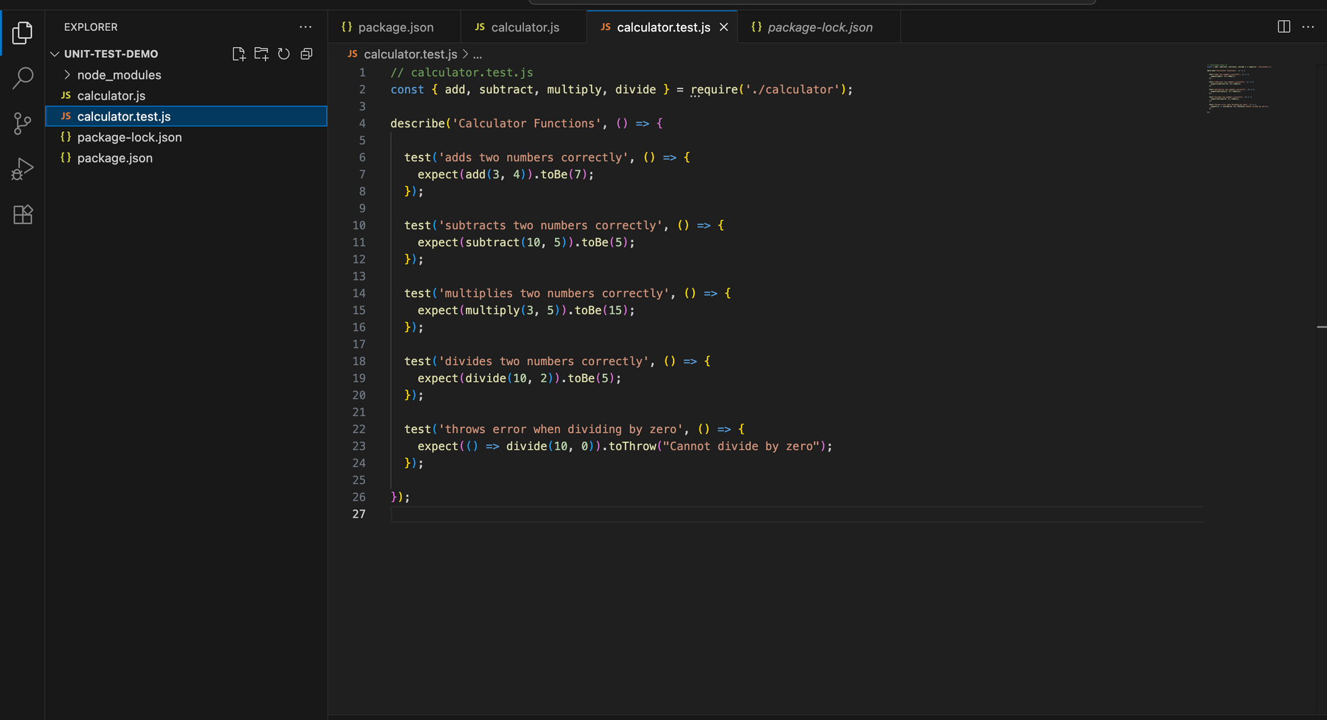

Slide 11
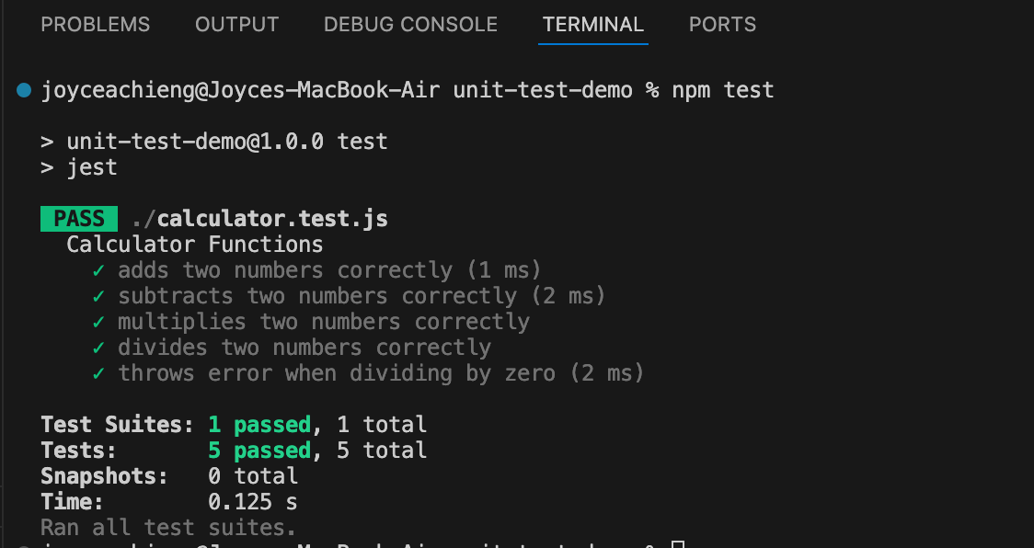

Slide 12

Thank You

